Slide 1
JavaScript: Introduction to Scripting
Outline
Introduction
Simple Program: Printing a Line of Text in a Web Page
Obtaining User Input with prompt Dialogs
Dynamic Welcome Page
Adding Integers
Memory Concepts
Arithmetic
Decision Making: Equality and Relational Operators

Slide 2
Objectives
In this lesson, you will learn:
To be able to write simple JavaScript programs.
To be able to use input and output statements.
To understand basic memory concepts.
To be able to use arithmetic operators.
To understand the precedence of arithmetic operators.
To be able to write decision-making statements.
To be able to use relational and equality operators.

Slide 3
1 Introduction
JavaScript scripting language
Enhances functionality and appearance
Client-side scripting
Makes pages more dynamic and interactive
Foundation for complex server-side scripting
Program development
Program control

Slide 4
2 Simple Program: Printing a Line of Text in a Web Page
Inline scripting
Written in the <body> of a document
<script> tag
Indicate that the text is part of a script
type attribute
Specifies the type of file and the scripting language use
writeln method
Write a line in the document
Escape character ( \ )
Indicates “special” character is used in the string
alert method
Dialog box

Slide 5
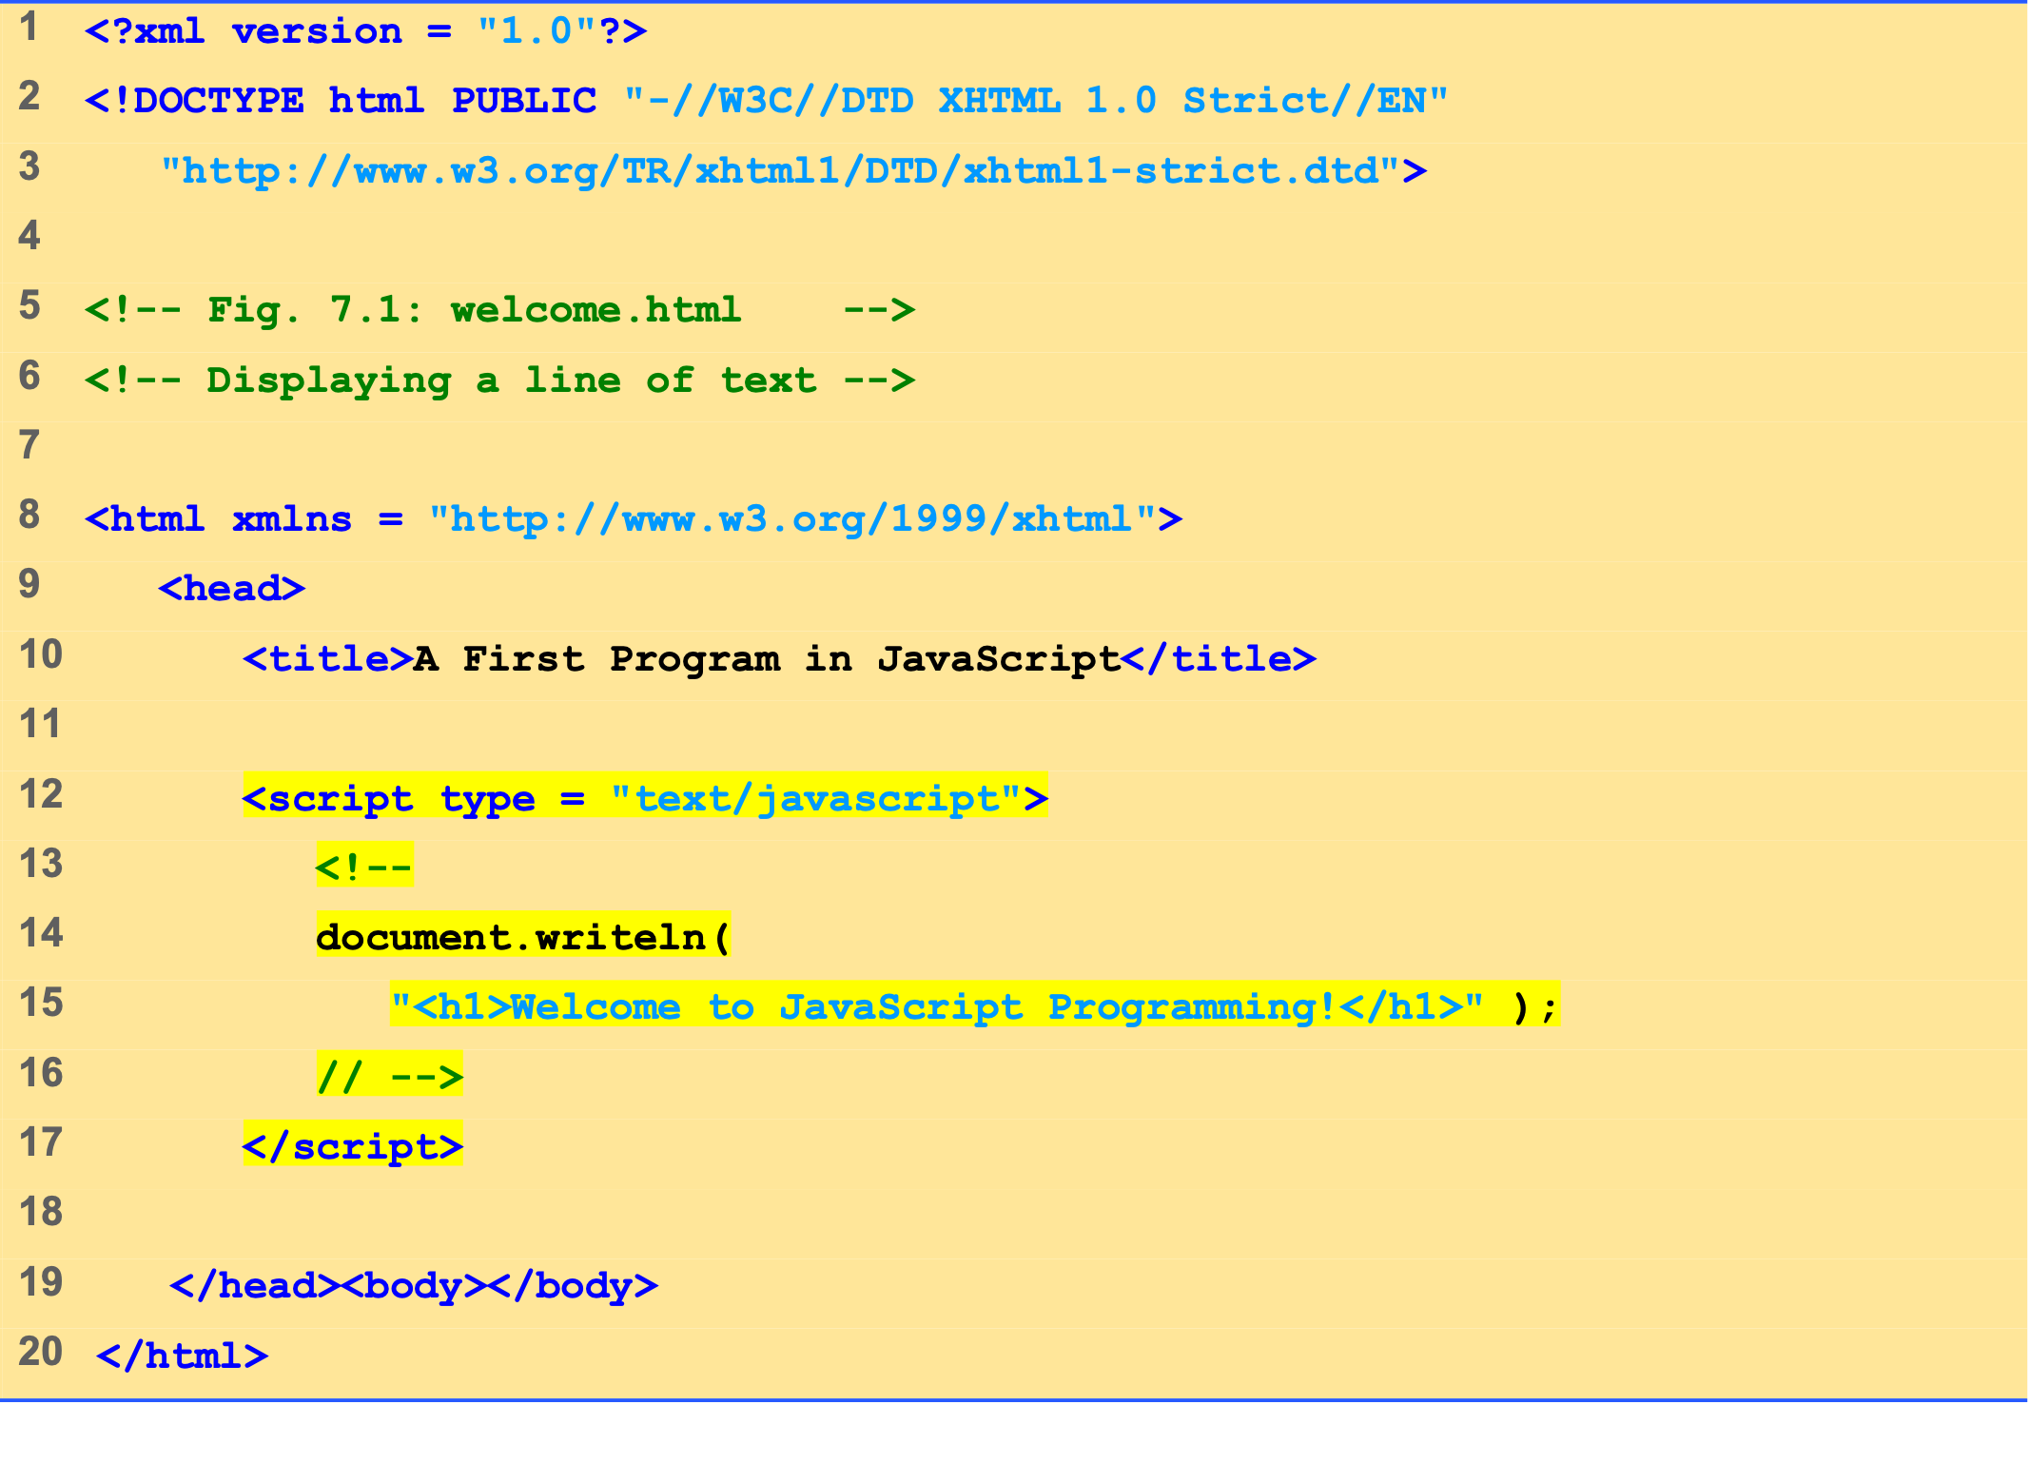
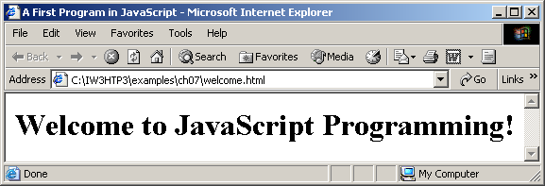
welcome.html (1 of 1)

Slide 6
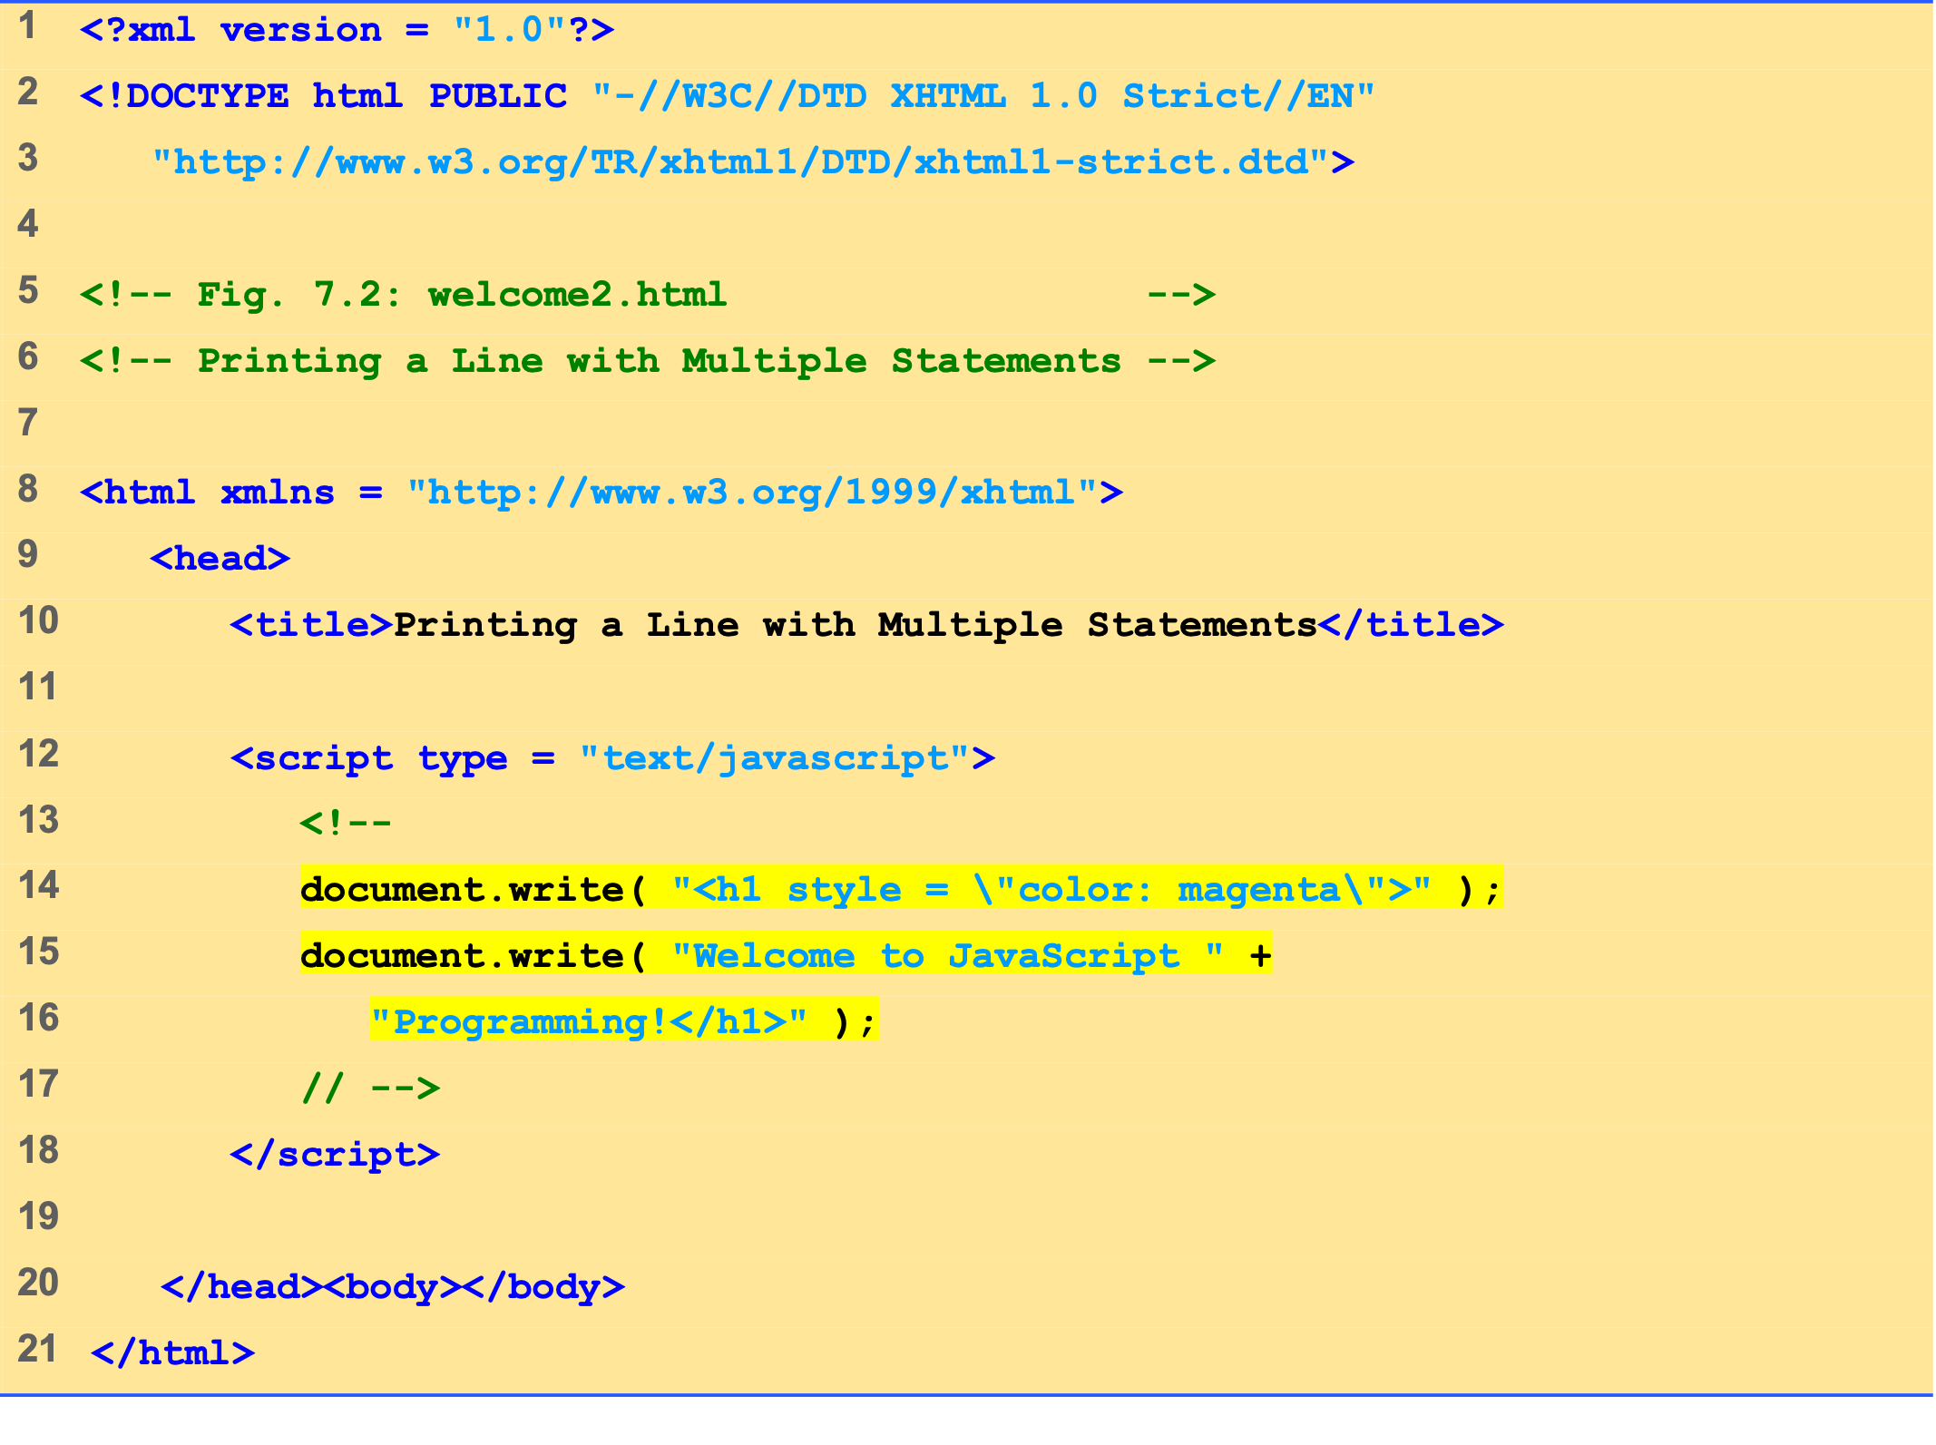
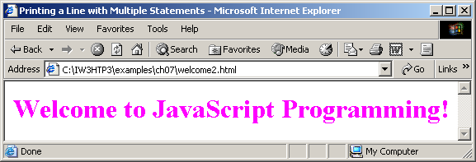
welcome2.html (1 of 1)

Slide 7
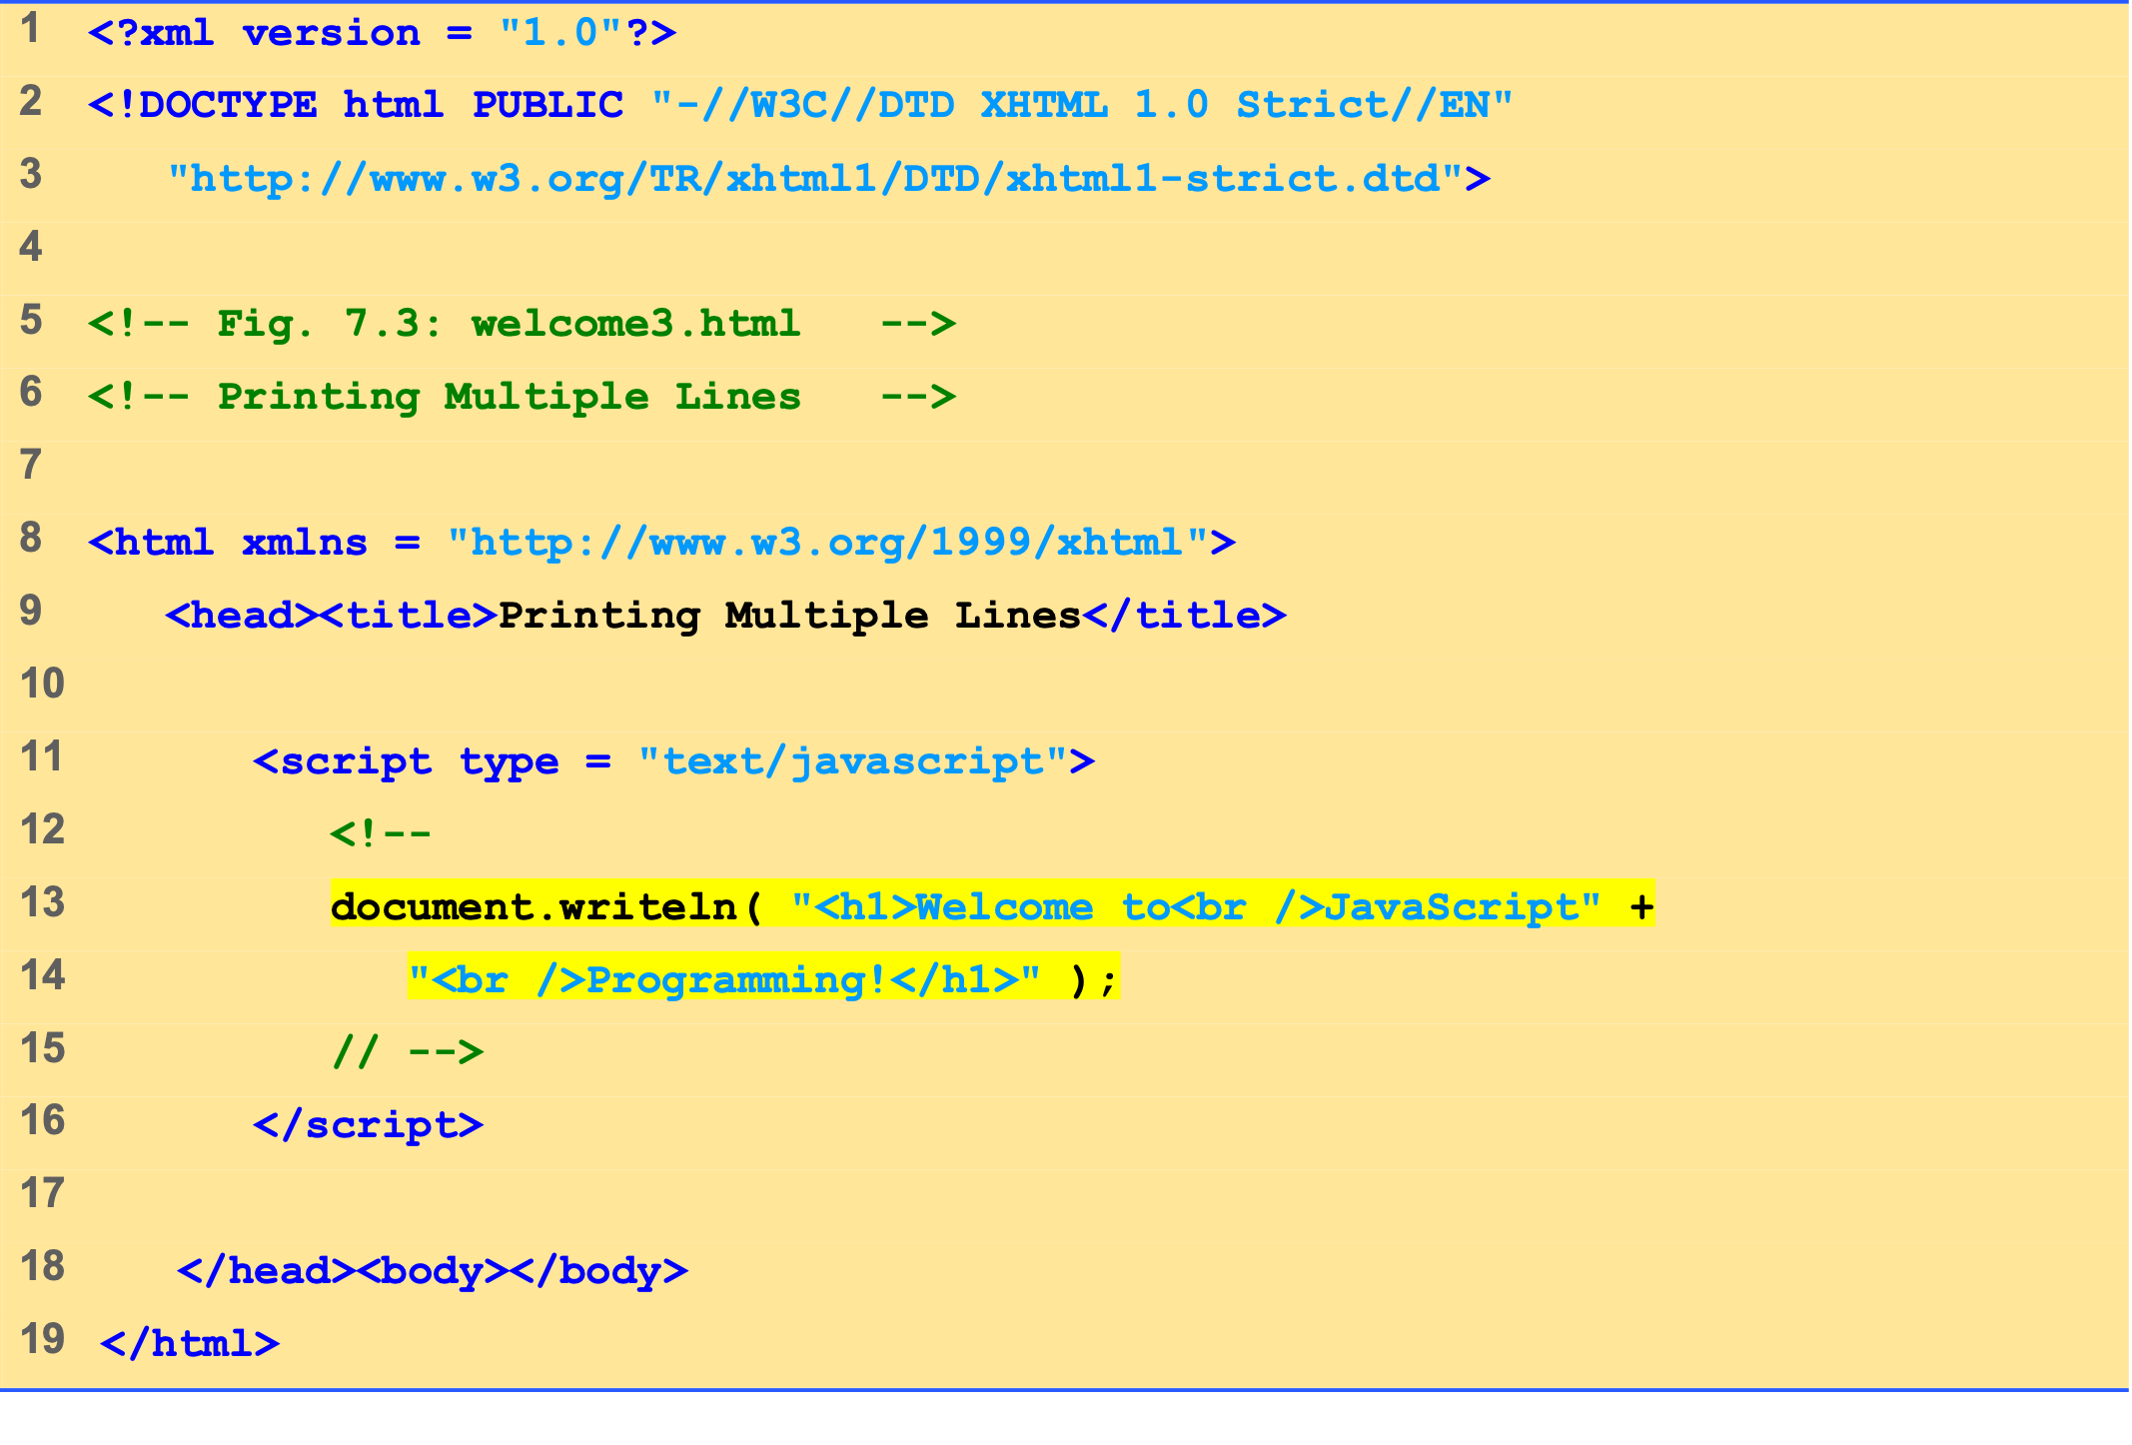
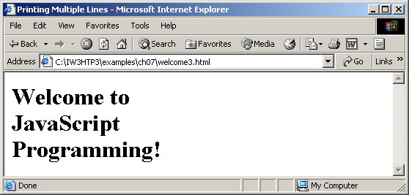
welcome3.html 1 of 1

Slide 8
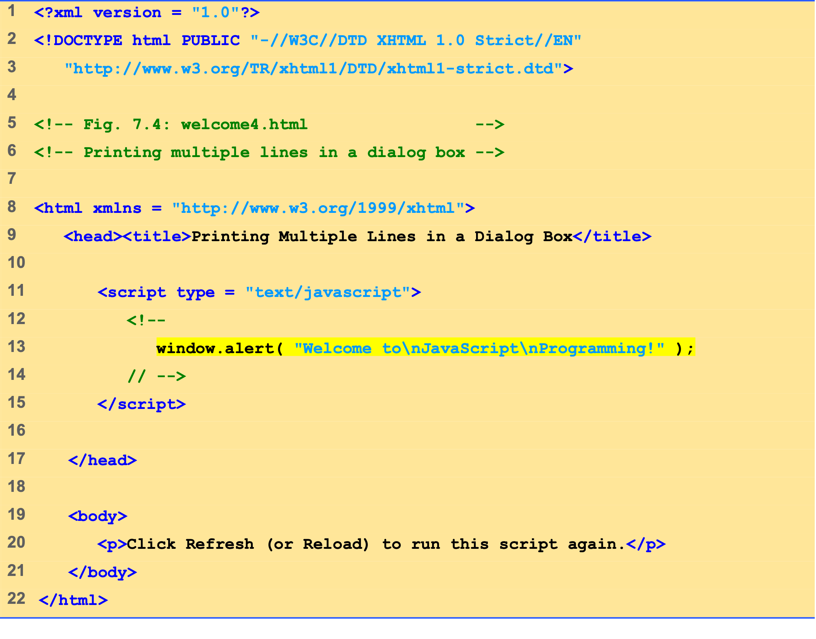
welcome4.html 1 of 1

Slide 9
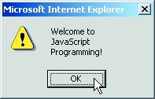
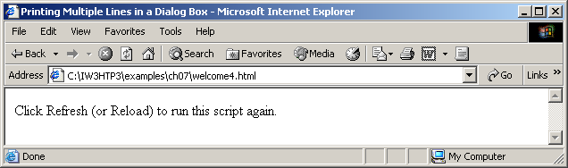

Slide 10
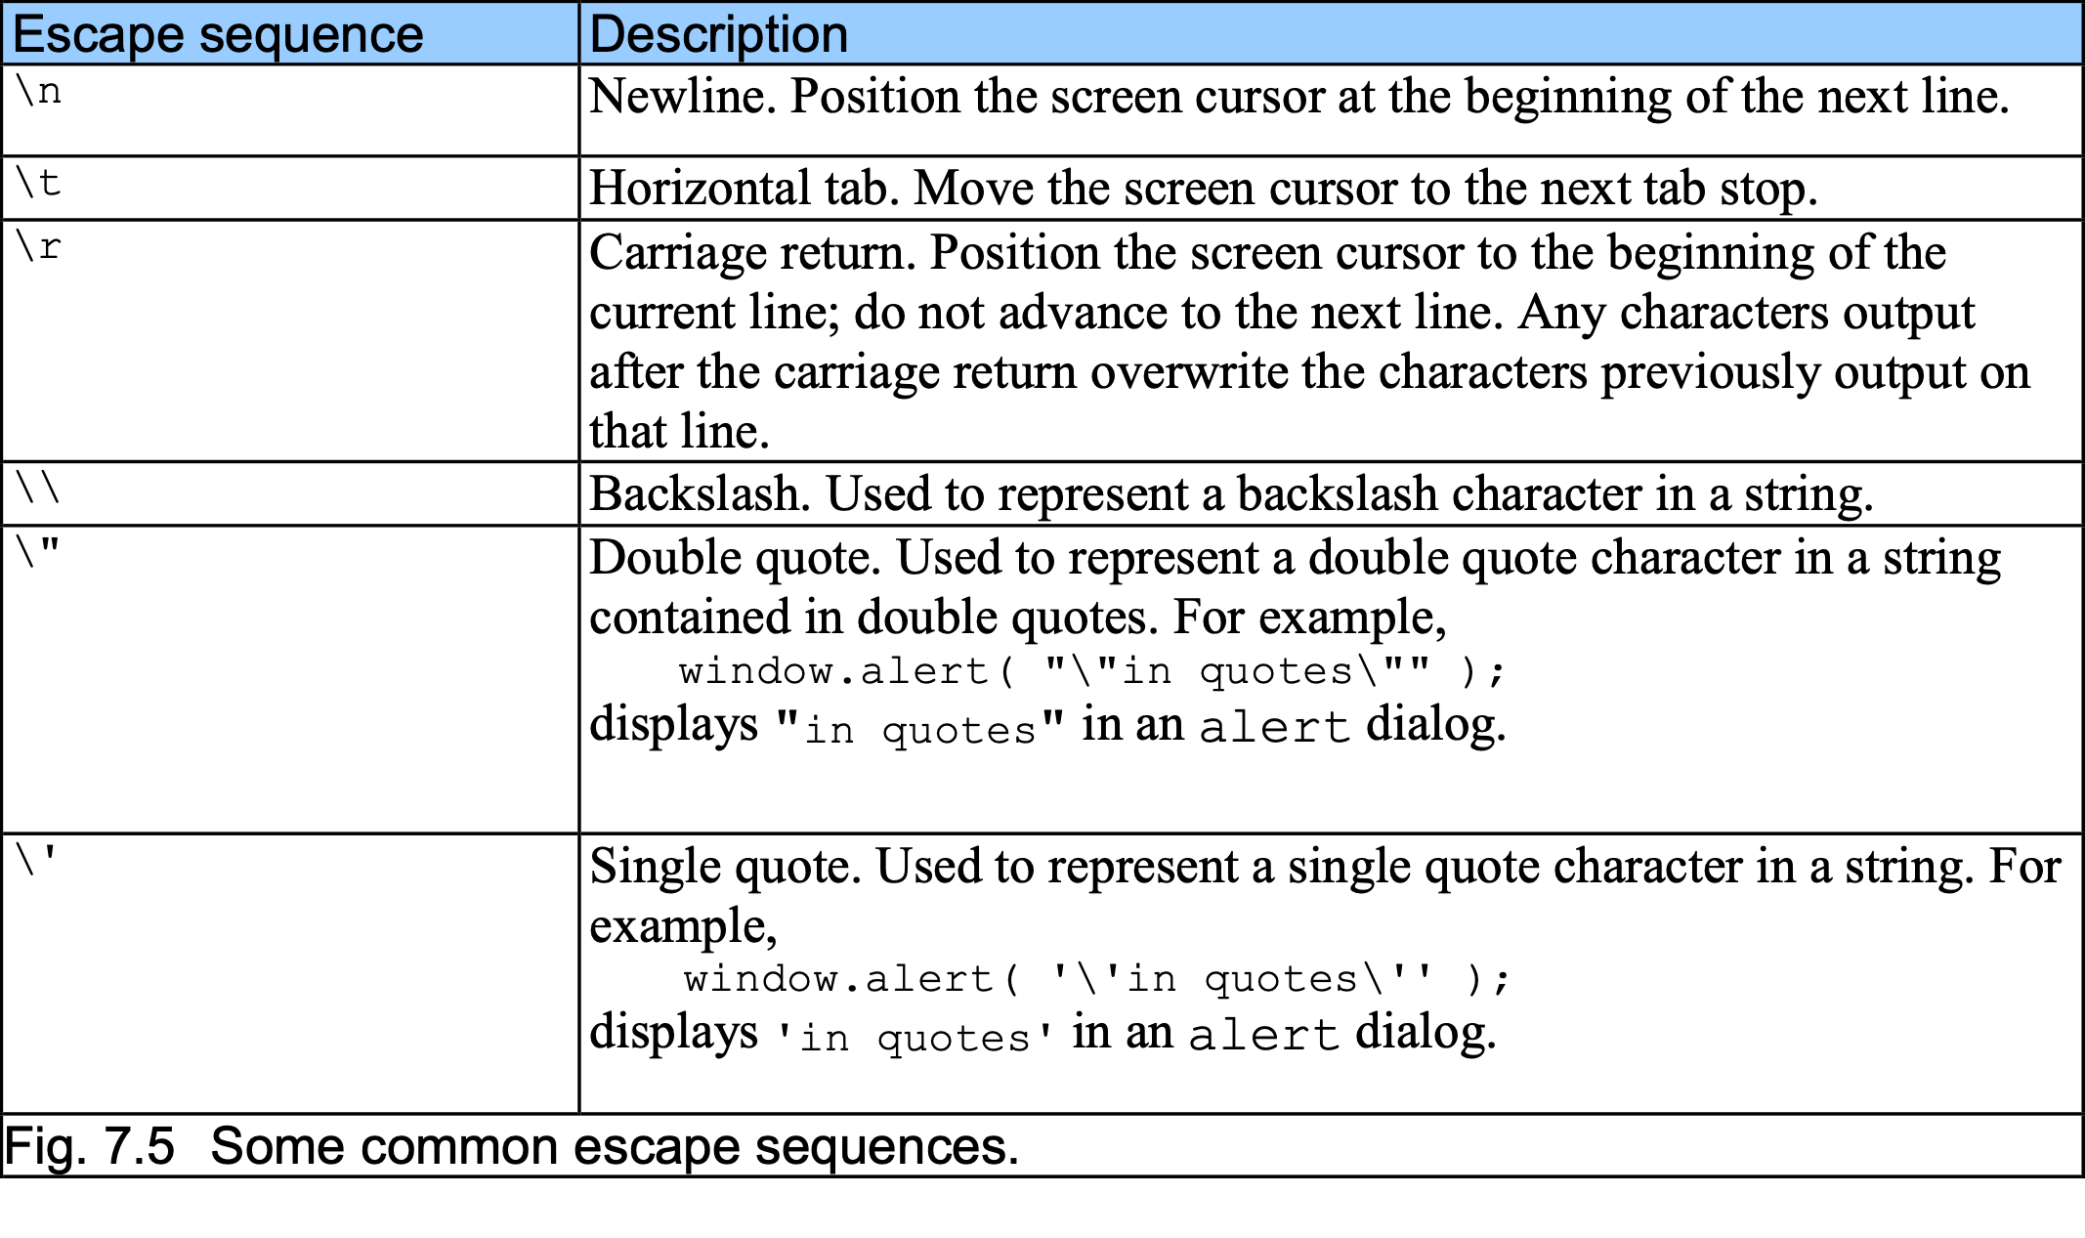
2 Simple Program: Printing a Line of Text in a Web Page

Slide 11
3 Dynamic Welcome Page
A script can adapt the content based on input from the user or other variables

Slide 12
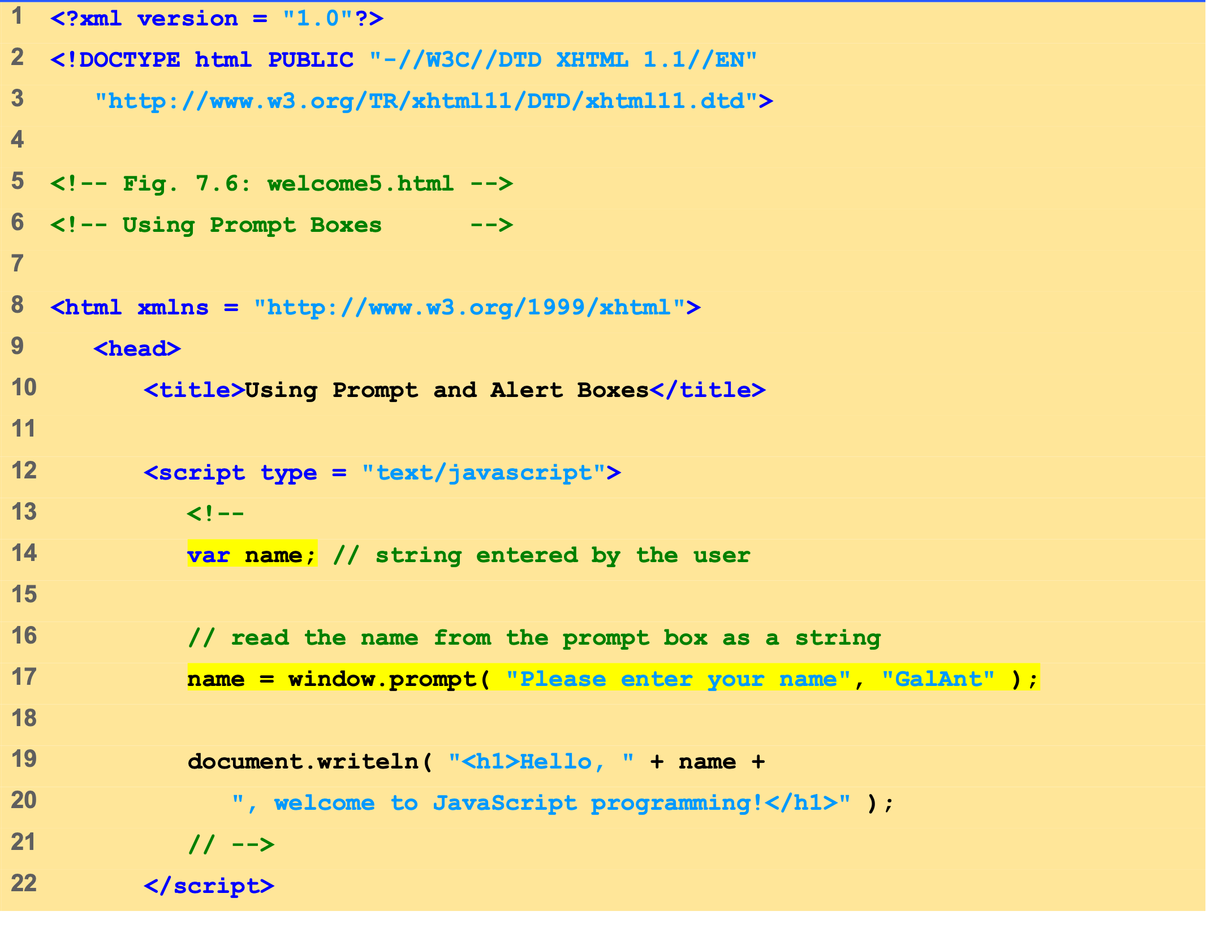
welcome5.html (1 of 2)

Slide 13
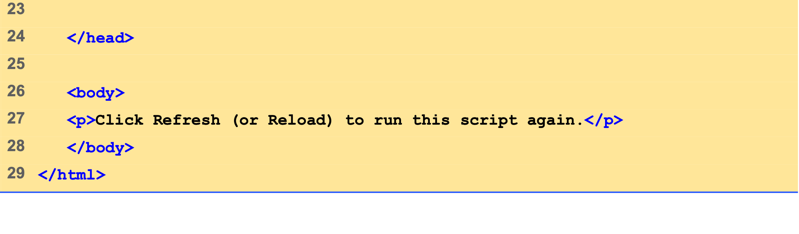
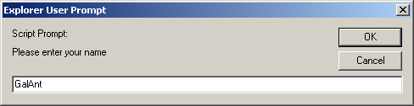
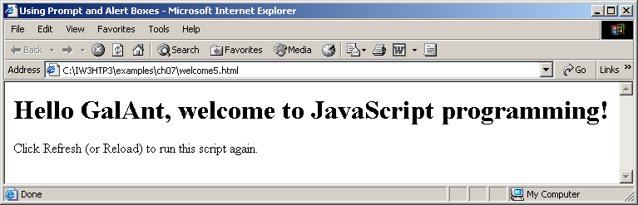
welcome5.html (2 of 2)

Slide 14
3.1 Dynamic Welcome Page
When the user clicks OK, the value typed by the user is returned to the program as a string.
This is the prompt to the user.
This is the text field in which the user types the value.
This is the default value that appears when the dialog opens.

Slide 15
3.2 Adding Integers
Prompt user for two integers and calculate the sum (Fig. 7.8)
NaN (not a number)
parseInt
Converts its string argument to an integer

Slide 16
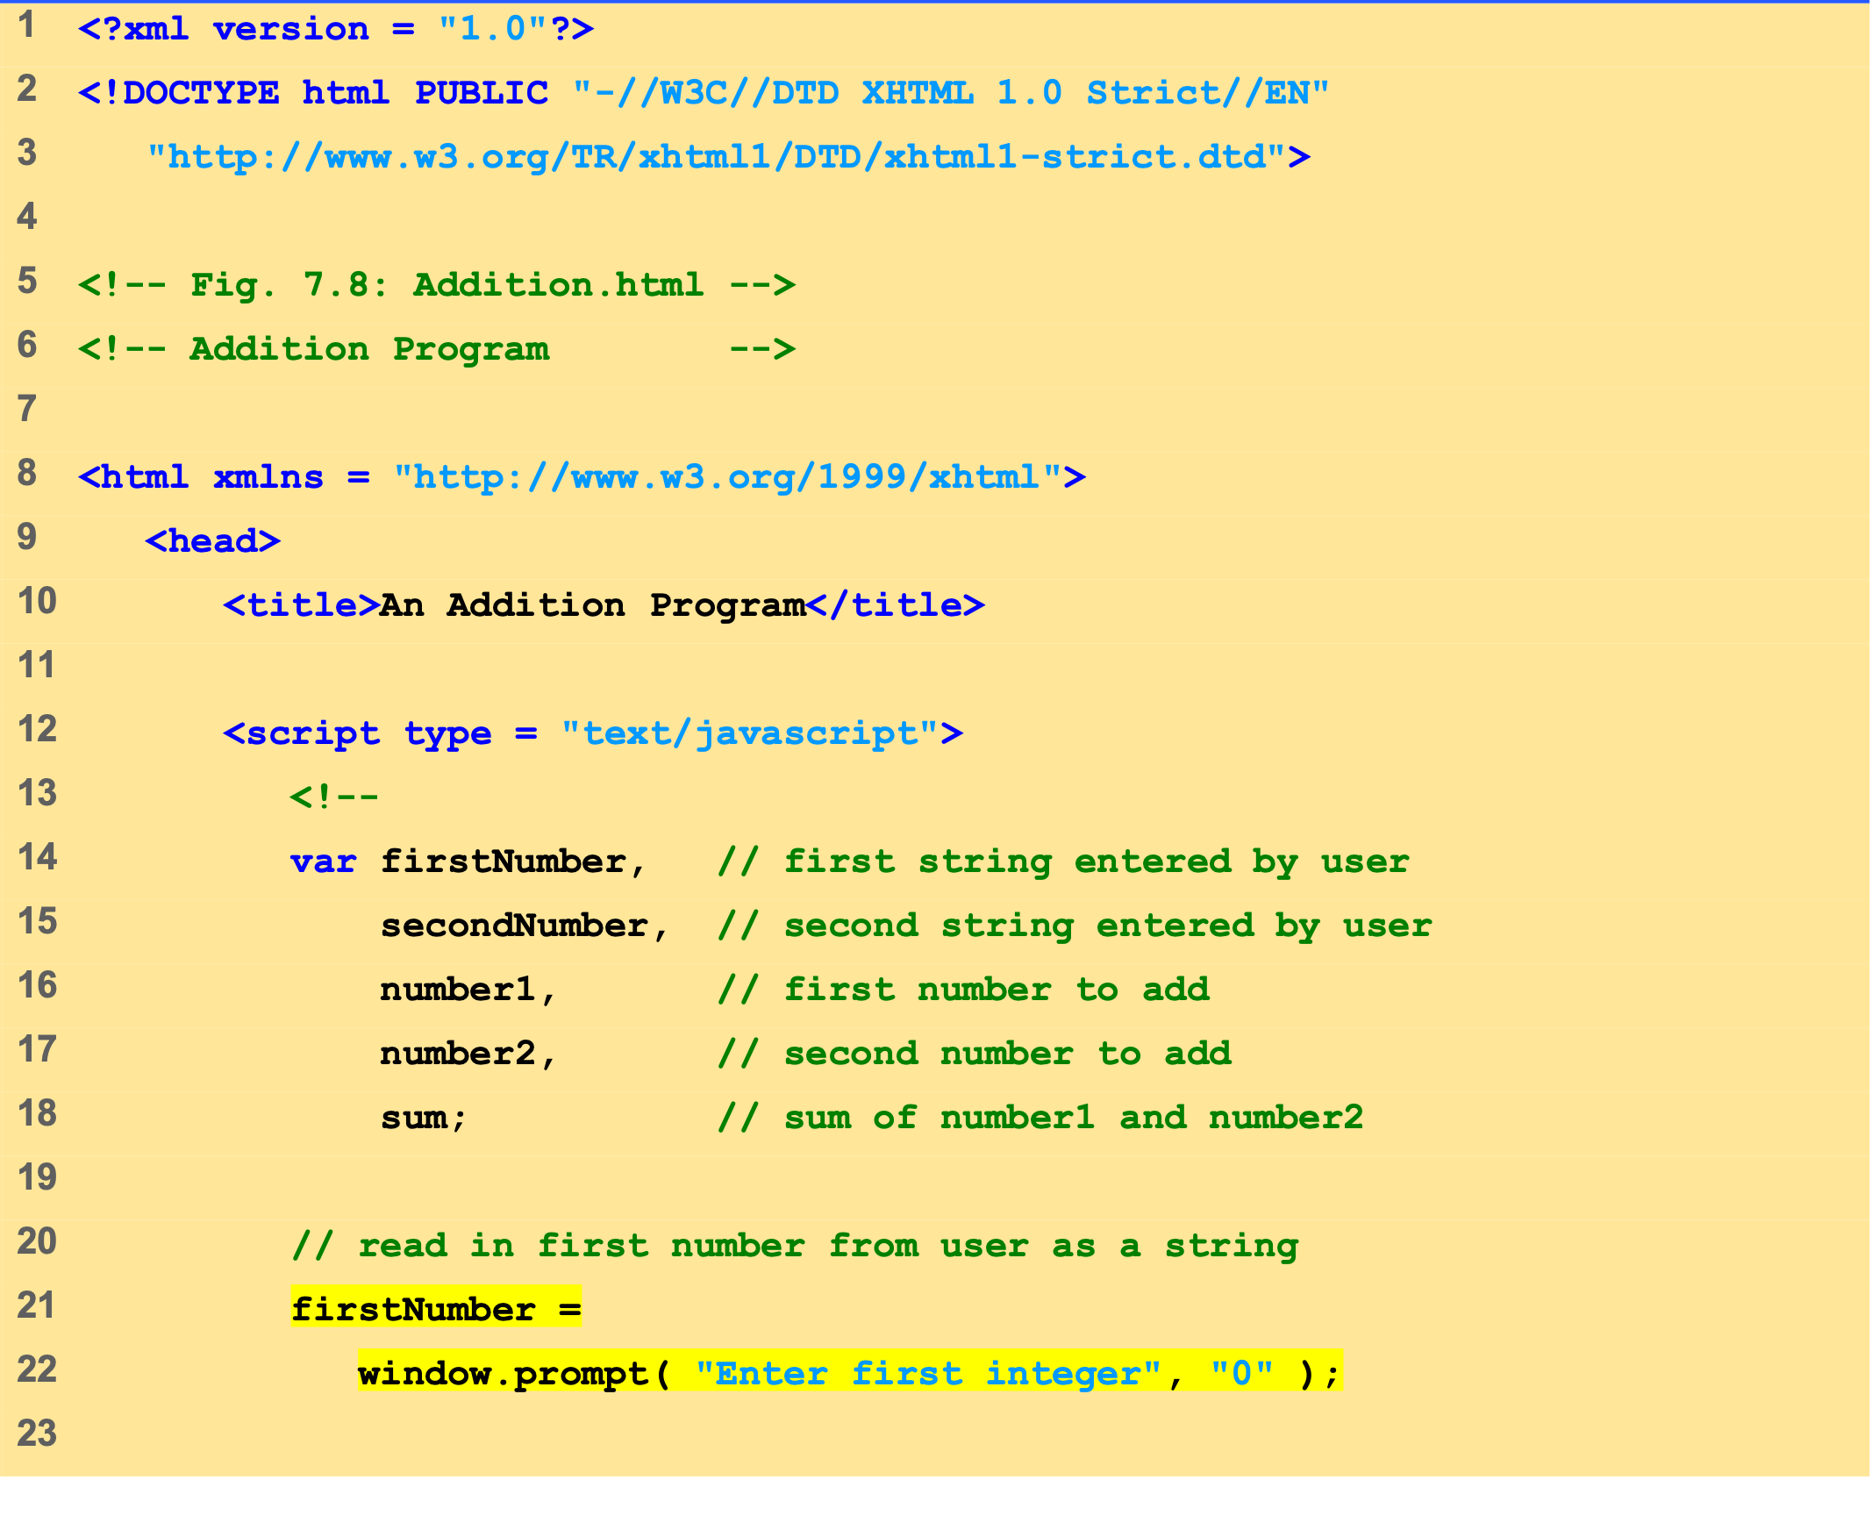
Addition.html (1 of 2)

Slide 17
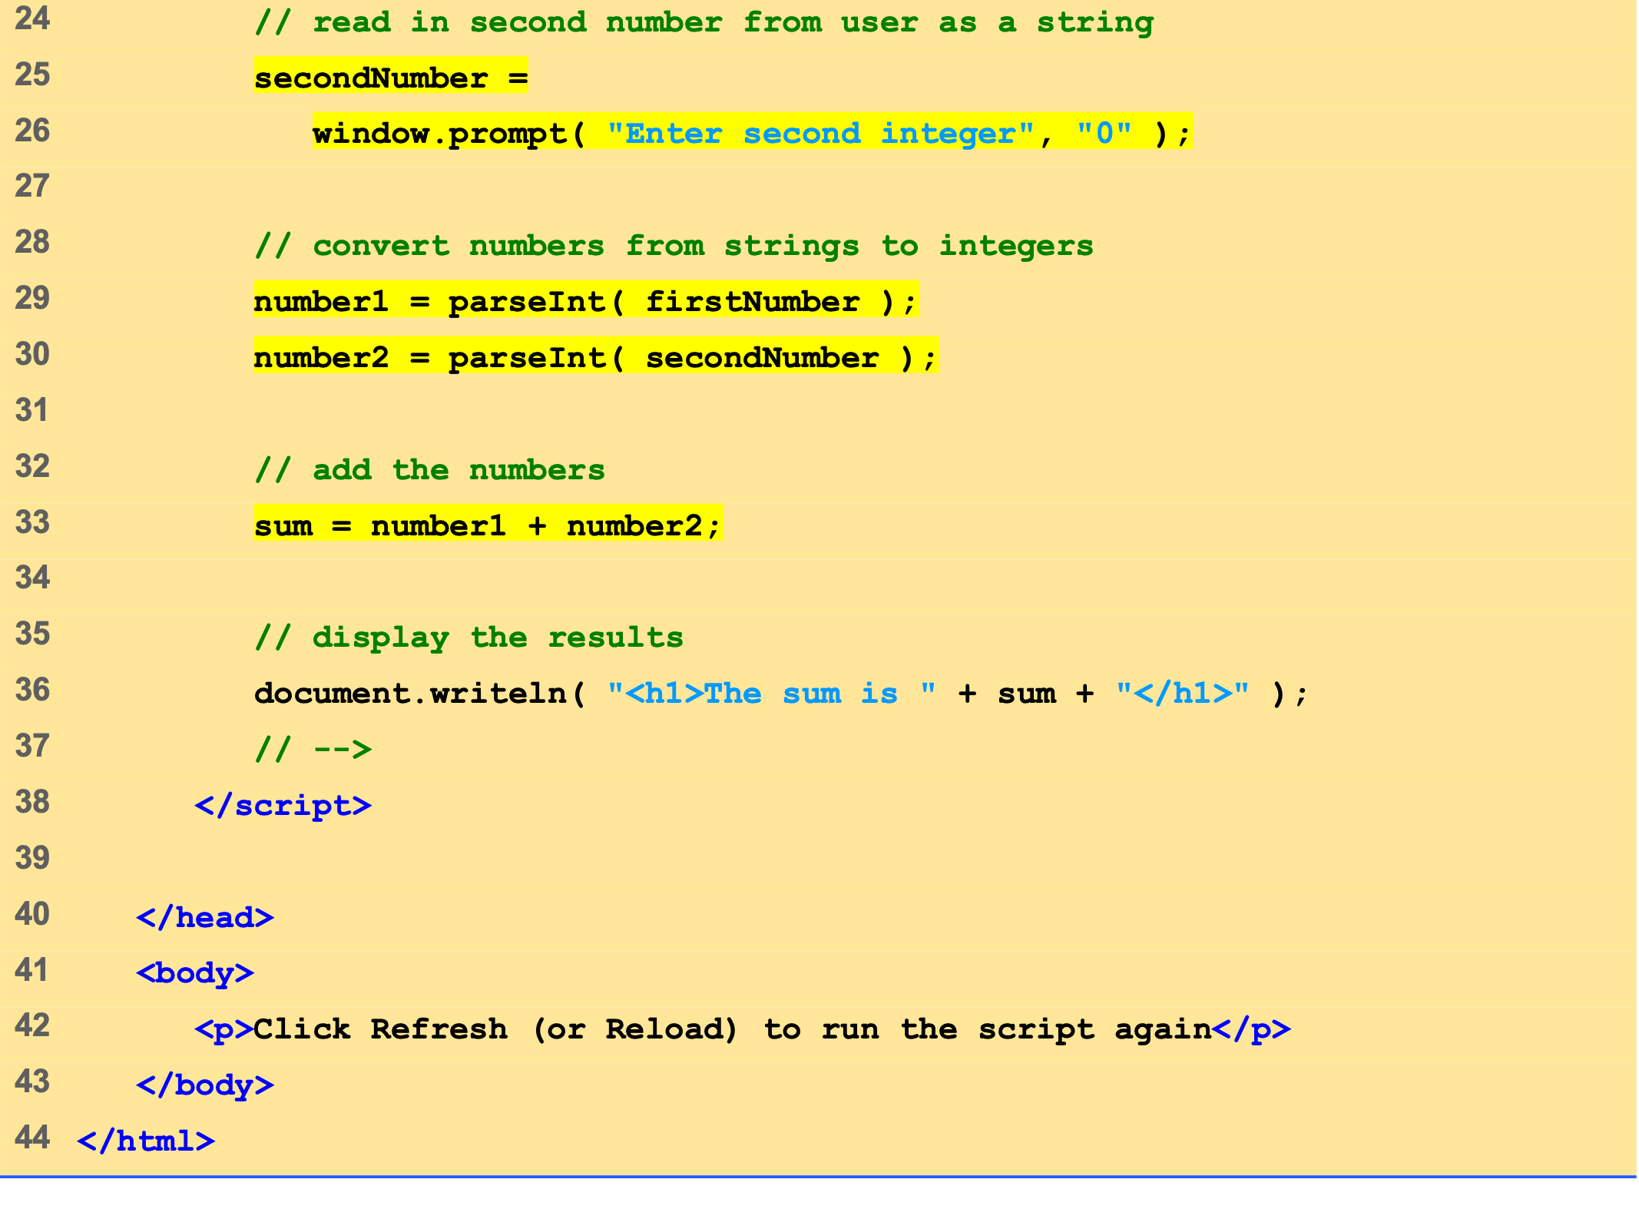
Addition.html (2 of 2)

Slide 18
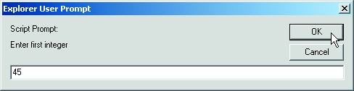
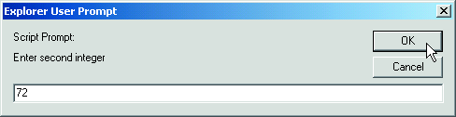
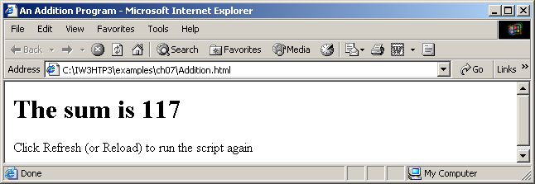

Slide 19
4 Memory Concepts
Variable names correspond to locations in the computer’s memory
Every variable has a name, a type, and a value
Read value from a memory location
nondestructive

Slide 20
4 Memory Concepts
number1
45

Slide 21
4 Memory Concepts
number1
45
number2
72

Slide 22
4 Memory Concepts
number1
45
number2
72
sum
117

Slide 23
5 Arithmetic
Many scripts perform arithmetic calculations
Expressions in JavaScript must be written in straight-line form

Slide 24
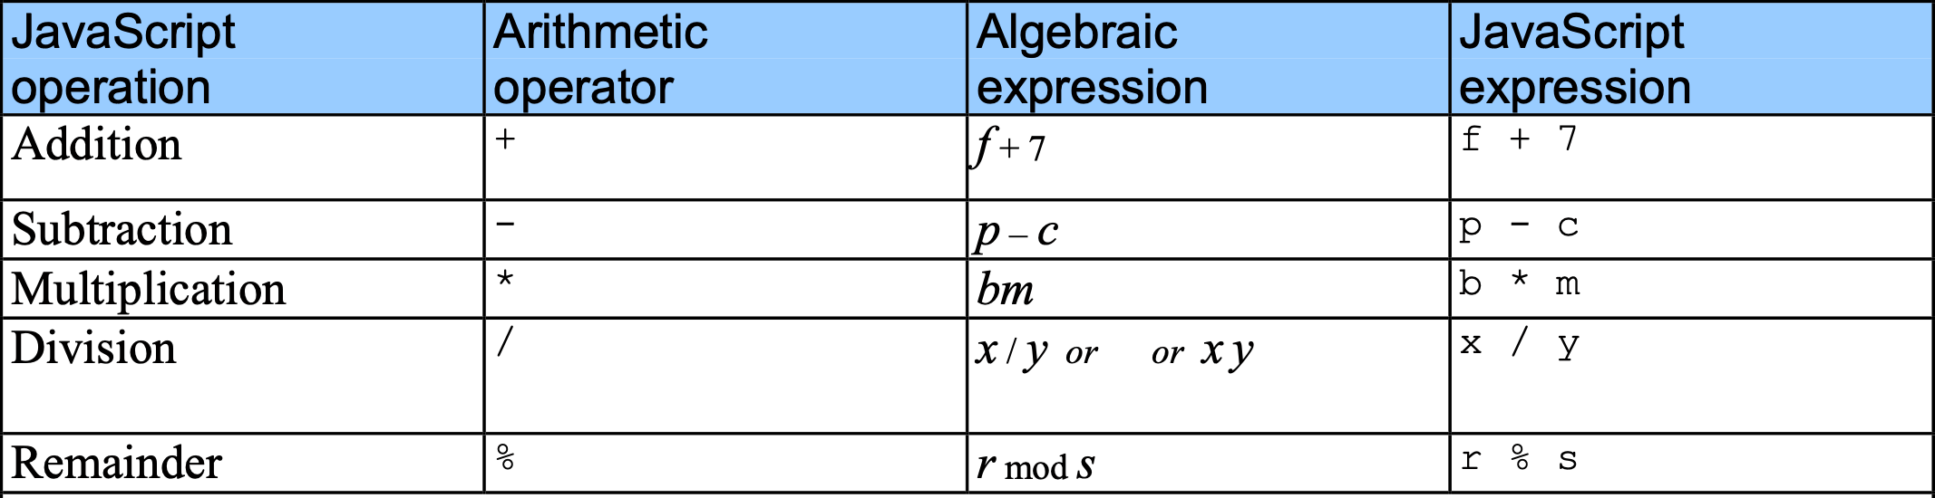
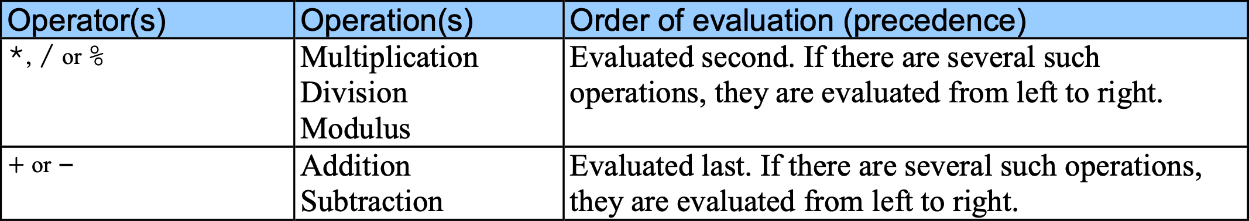
5 Arithmetic

Slide 25
5 Arithmetic
Step 1.
y = 2 * 5 * 5 + 3 * 5 + 7;
2 * 5 is 10
(Leftmost multiplication)
Step 2.
y = 10 * 5 + 3 * 5 + 7;
10 * 5 is 50
(Leftmost multiplication)
Step 3.
y = 50 + 3 * 5 + 7;
3 * 5 is 15
(Multiplication before addition)
Step 4.
y = 50 + 15 + 7;
50 + 15 is 65
(Leftmost addition)
Step 5.
y = 65 + 7;
65 + 7 is 72
(Last addition)
Step 6.
y = 72;
(Last operation—place
72
into
y
)

Slide 26
6 Decision Making: Equality and Relational Operators
Decision based on the truth or falsity of a condition
Equality operators
Relational operators

Slide 27
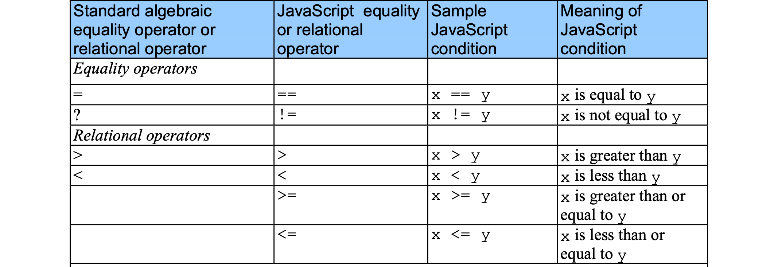
6 Decision Making: Equality and Relational Operators
³
£

Slide 28
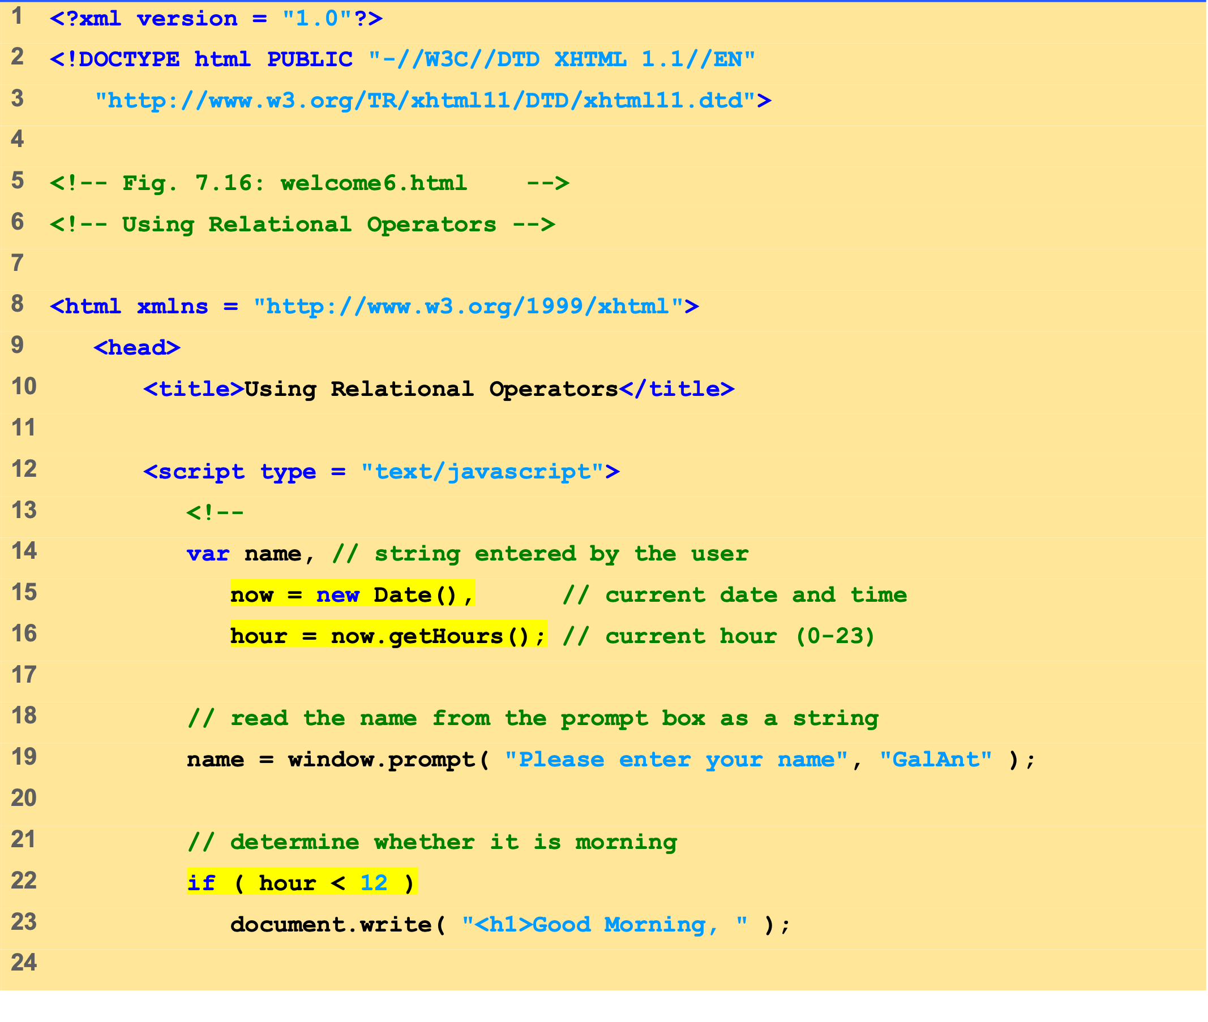
welcome6.html (1 of 3)

Slide 29
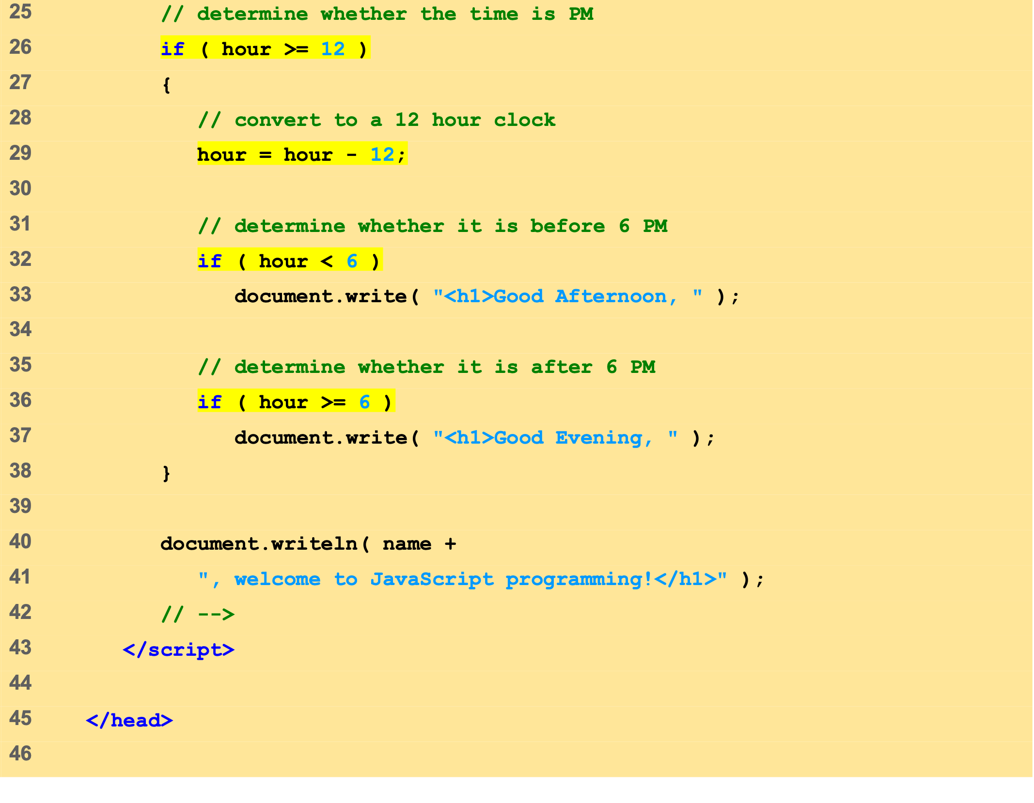
welcome6.html (2 of 3)

Slide 30
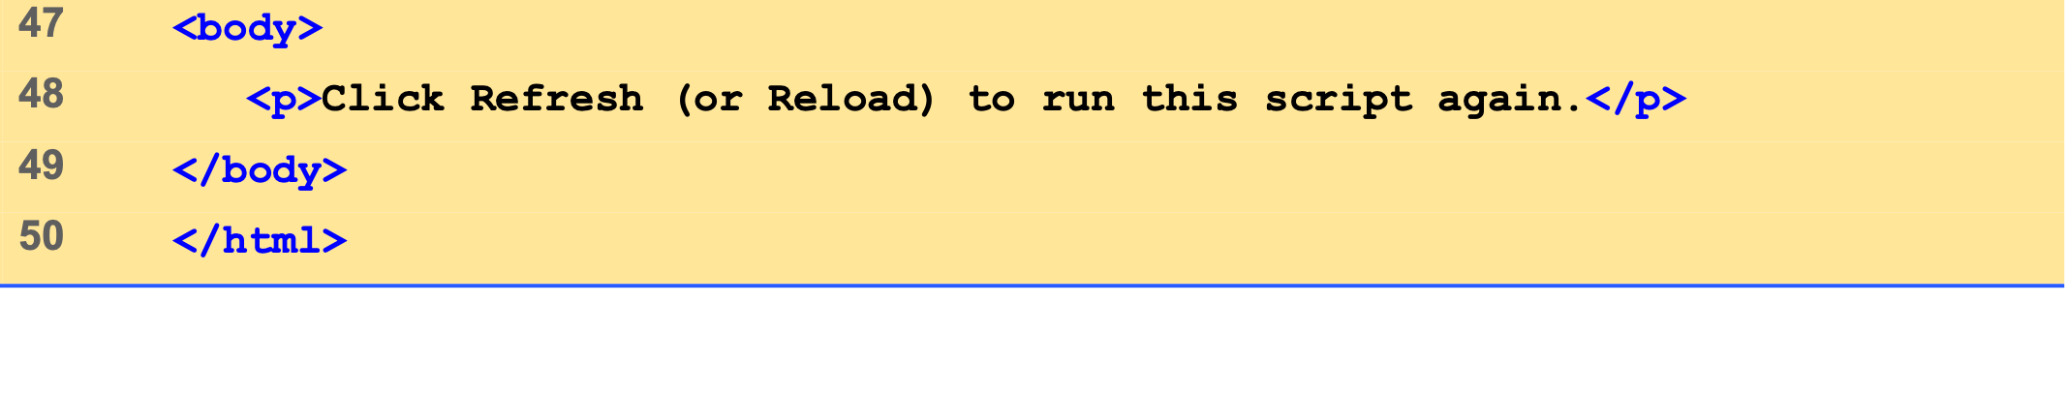
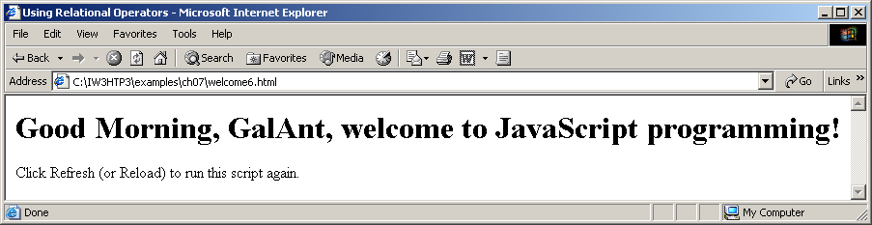
welcome6.html (3 of 3)

Slide 31
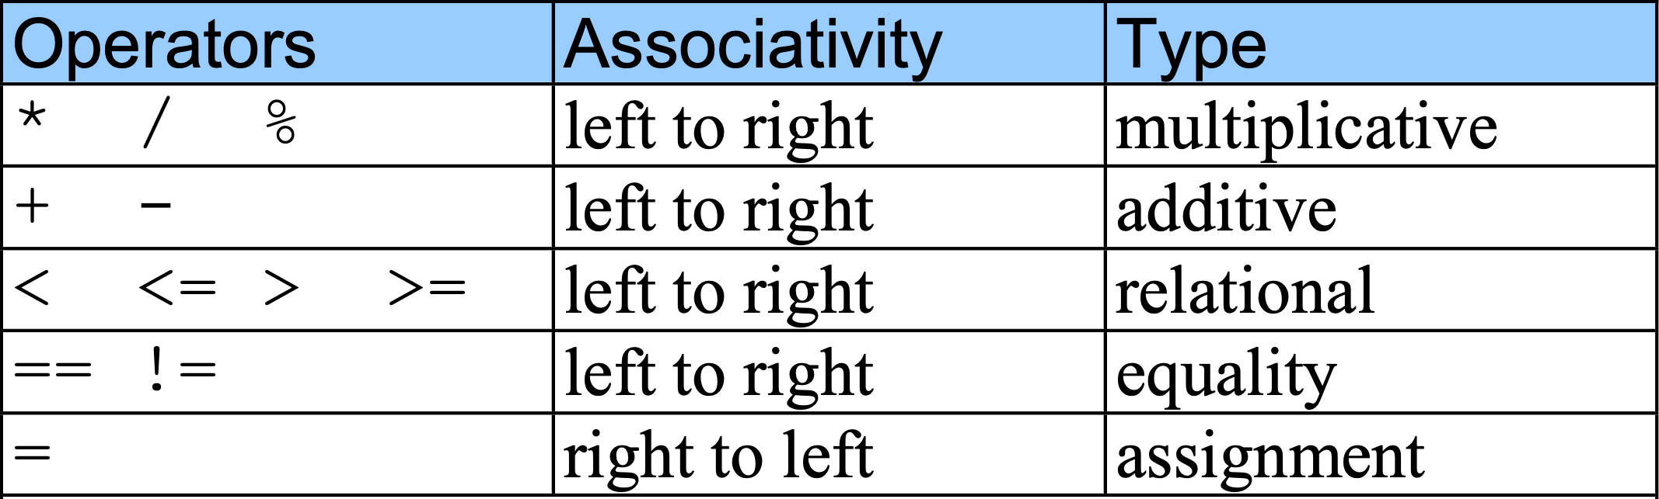
6 Decision Making: Equality and Relational Operators

Slide 32
Web Resources
www.javascriptmall.com
developer.netscape.com/tech/javascript
www.mozilla.org/js/language
Deitel and deitel, Internet and World Wide Web How to Program: Third Edition

